Slide 1
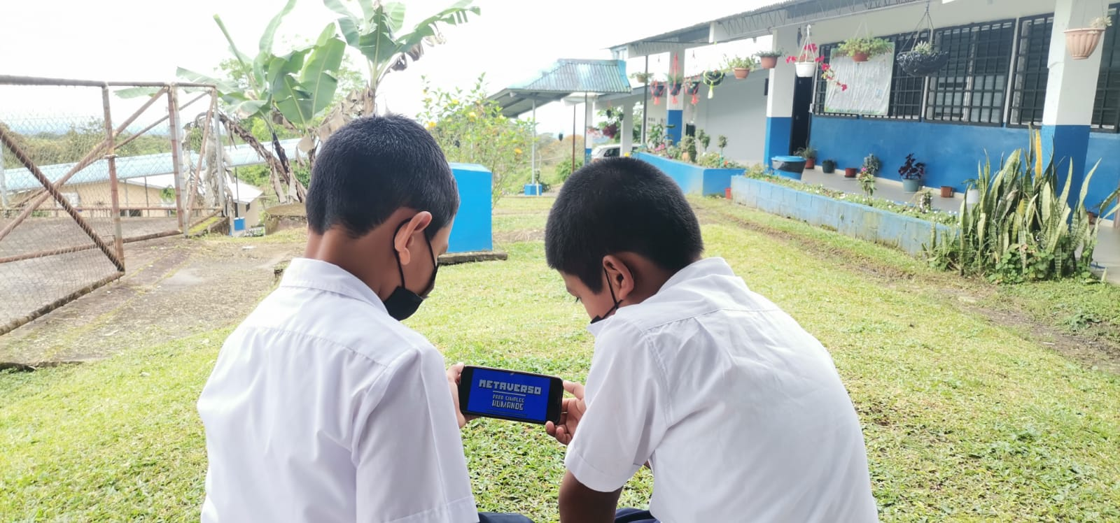
Object of study: present 3 public policies that governments should apply to ensure that rural youth can navigate the Internet safely, that they know how to identify a cyber attack and among other things.
Author: Milagro Suira
Law student and youth envoy of the International Telecommunications Union in the Americas.

Slide 2
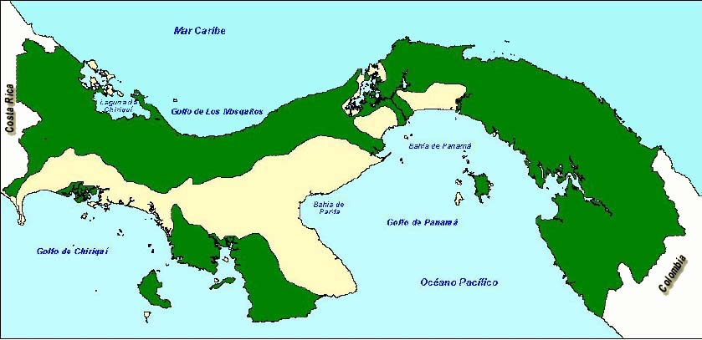

Slide 3
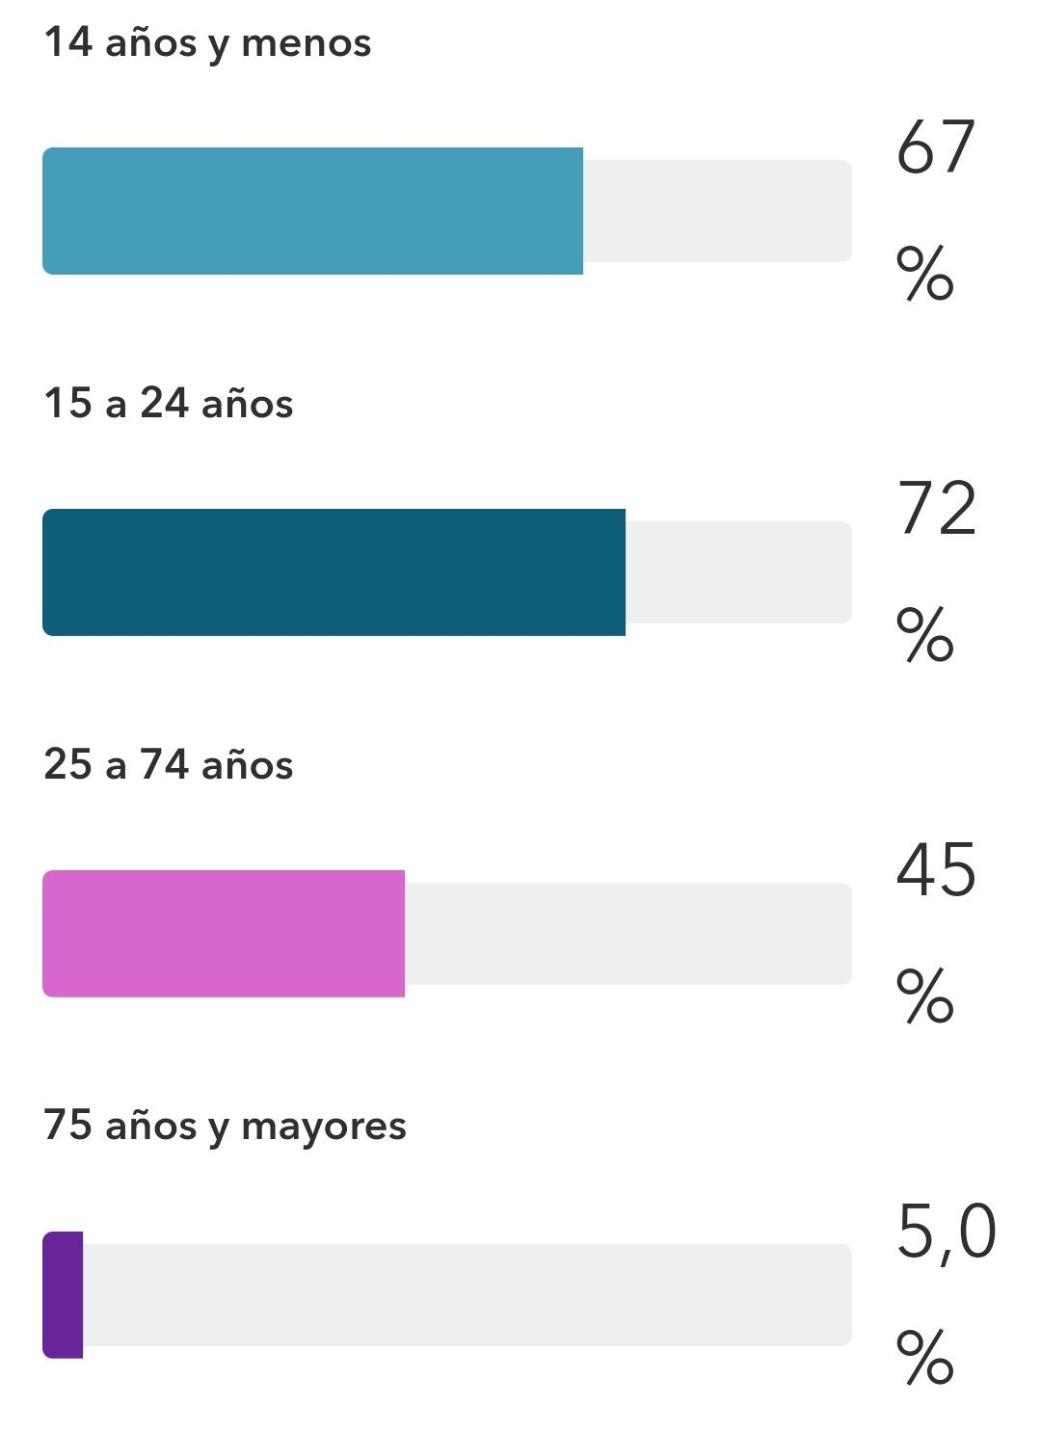
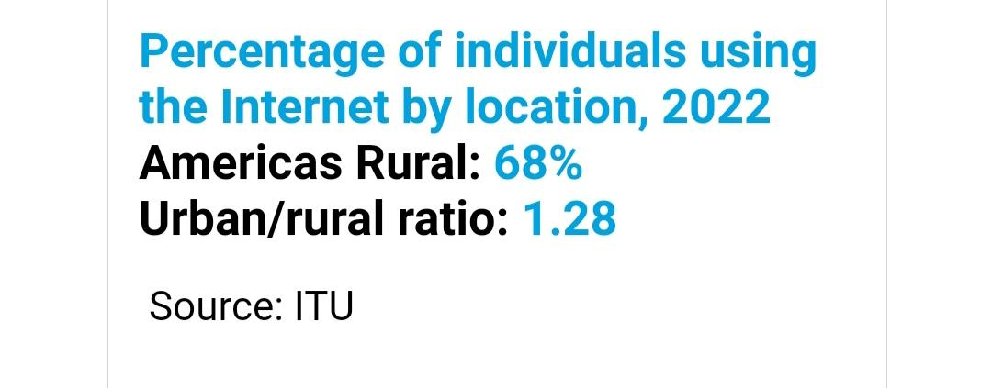
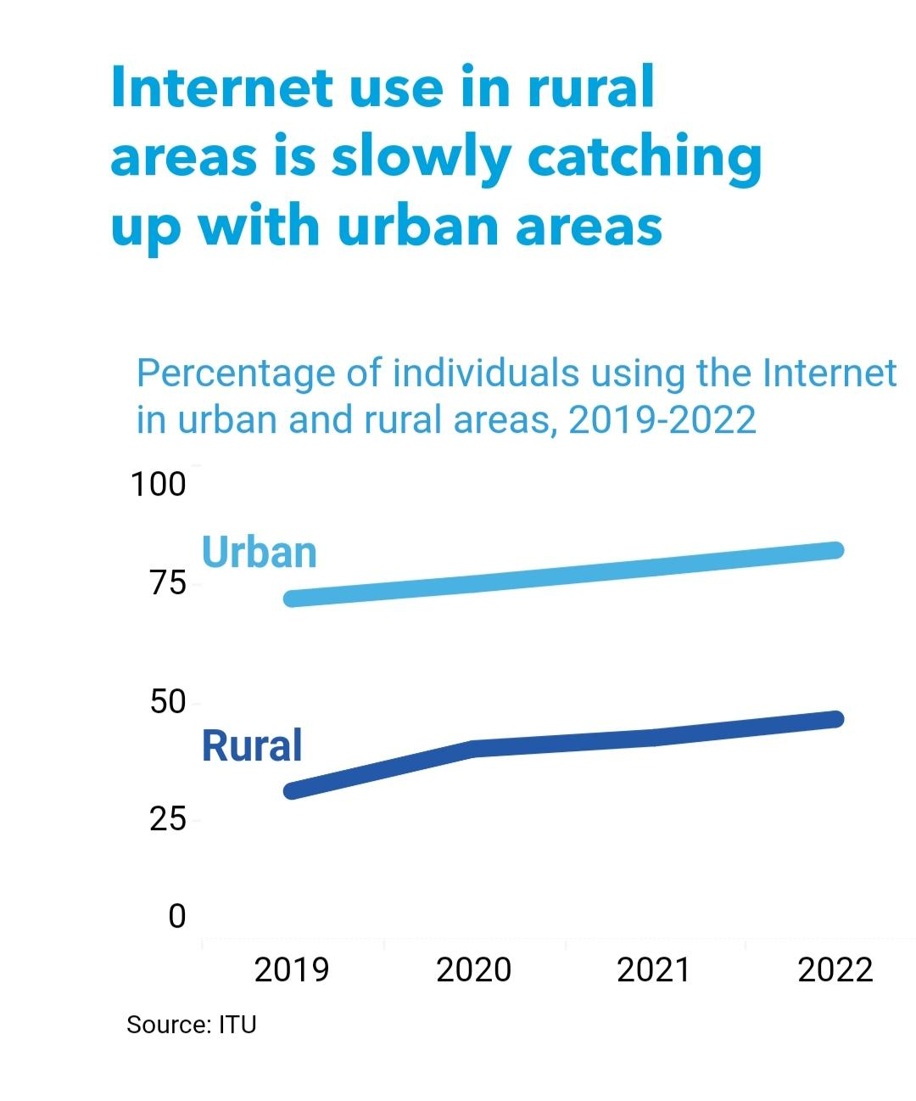
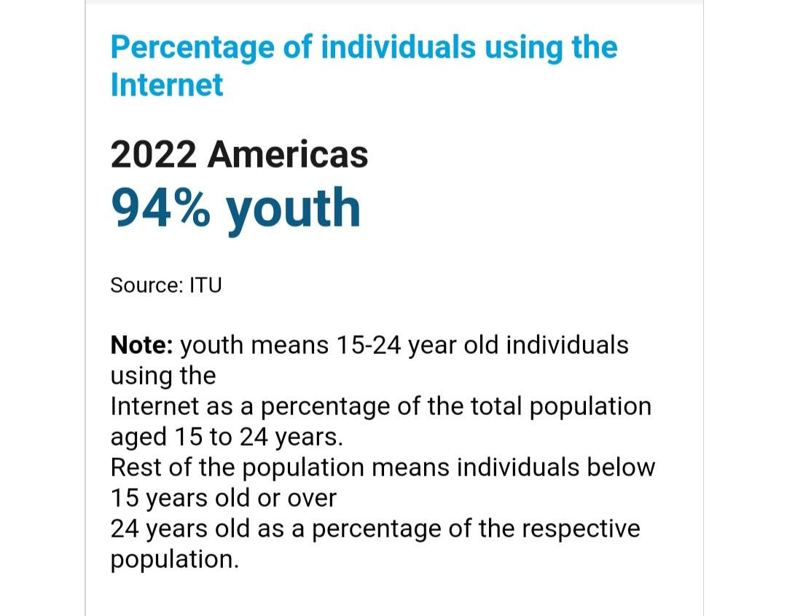
Data to consider.

Slide 4
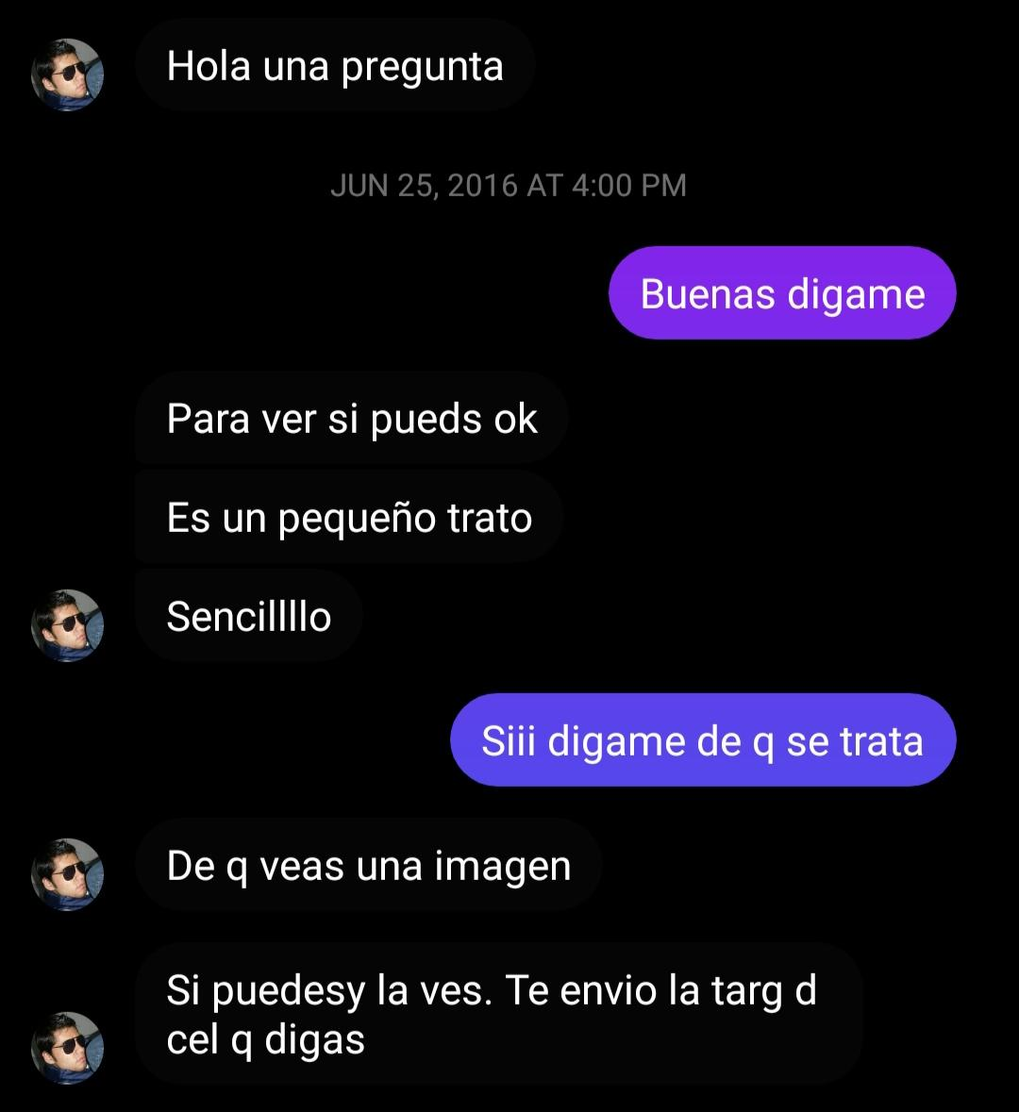


what's happening

Slide 5
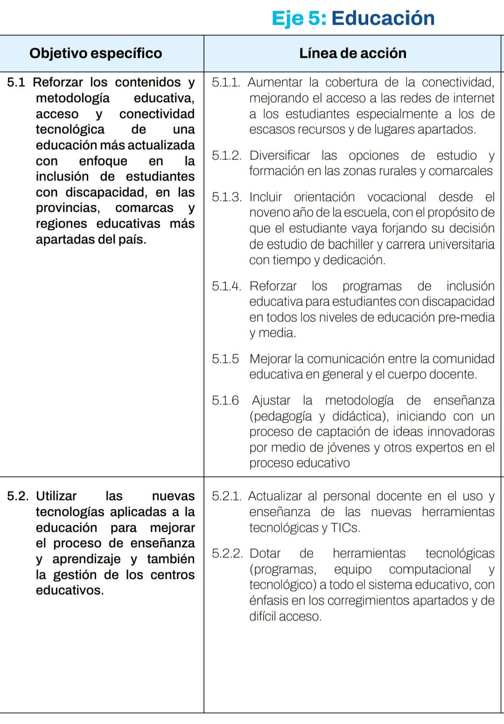
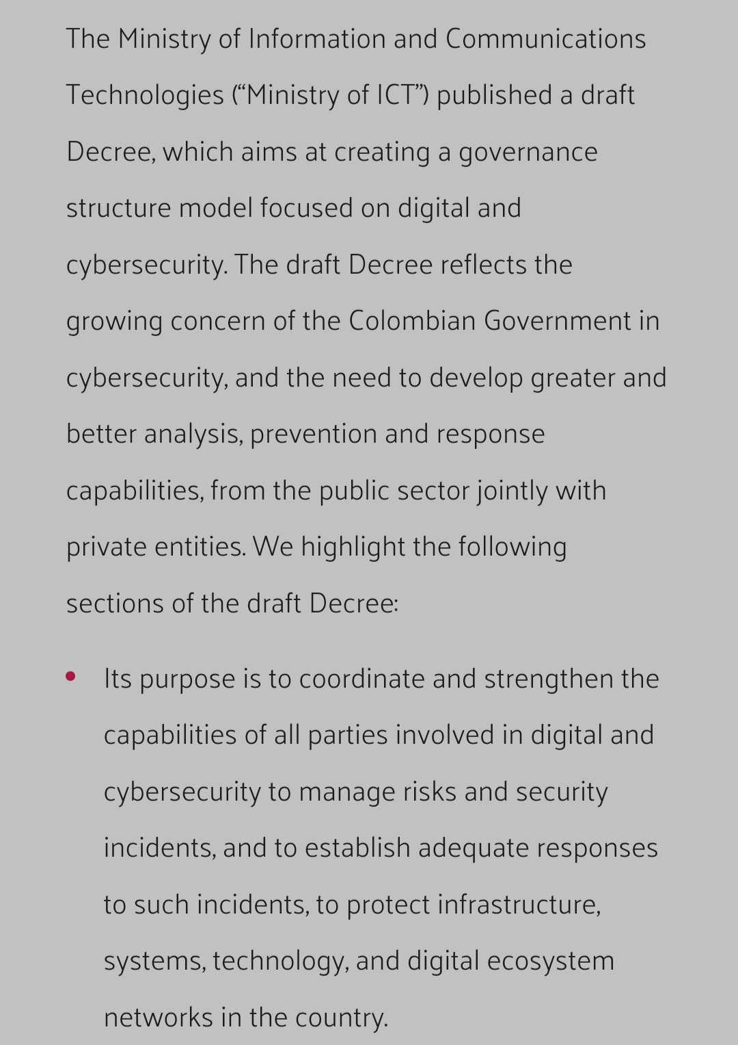
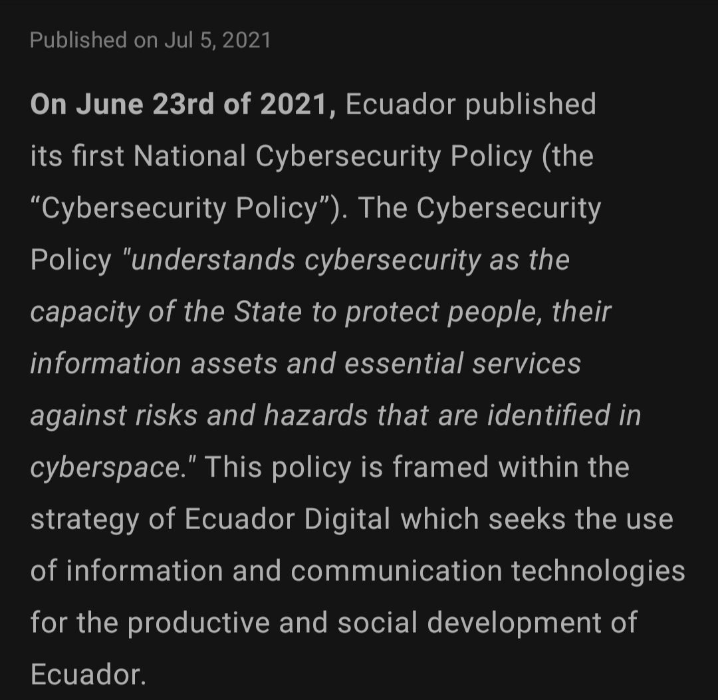
Panama
What does public policy say?
Others countries in the region

Slide 6
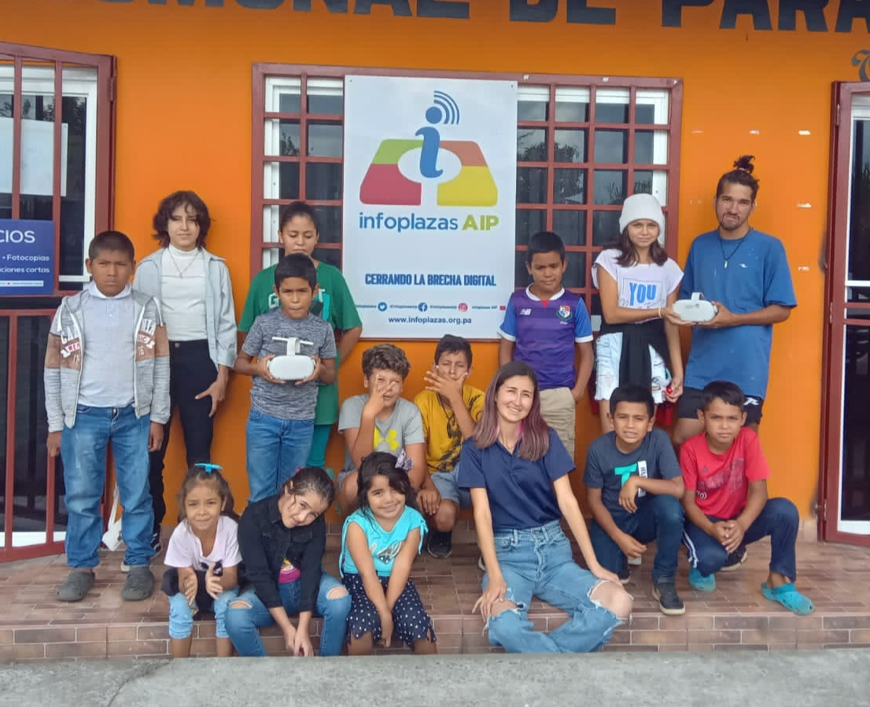
Create a digital literacy program.
Public policy 1
-Using infrastructure that already exists, such as info plazas in Panamá.
-With professionals who can come once a month to give a different workshop or activity.
- Implementation 2024-2029.

Slide 7
Establish a cyber incident response center:
Public policy 2
-Where complaints can be processed.
-Using existing infrastructure.
- With professionals trained to guide Young people.

Slide 8
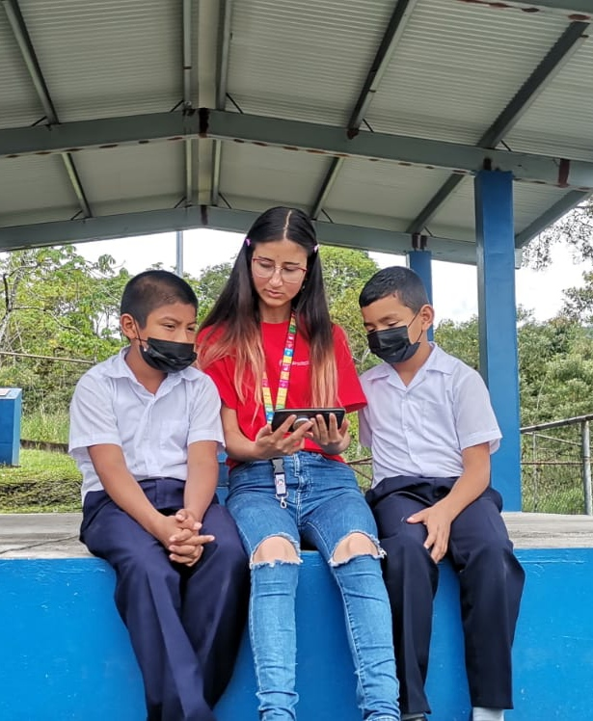
Establish a telephone helpline
Public policy 3:
-Connected to the response center.
-Operating on a strategic schedule.
- To cover remote access areas.

Slide 9
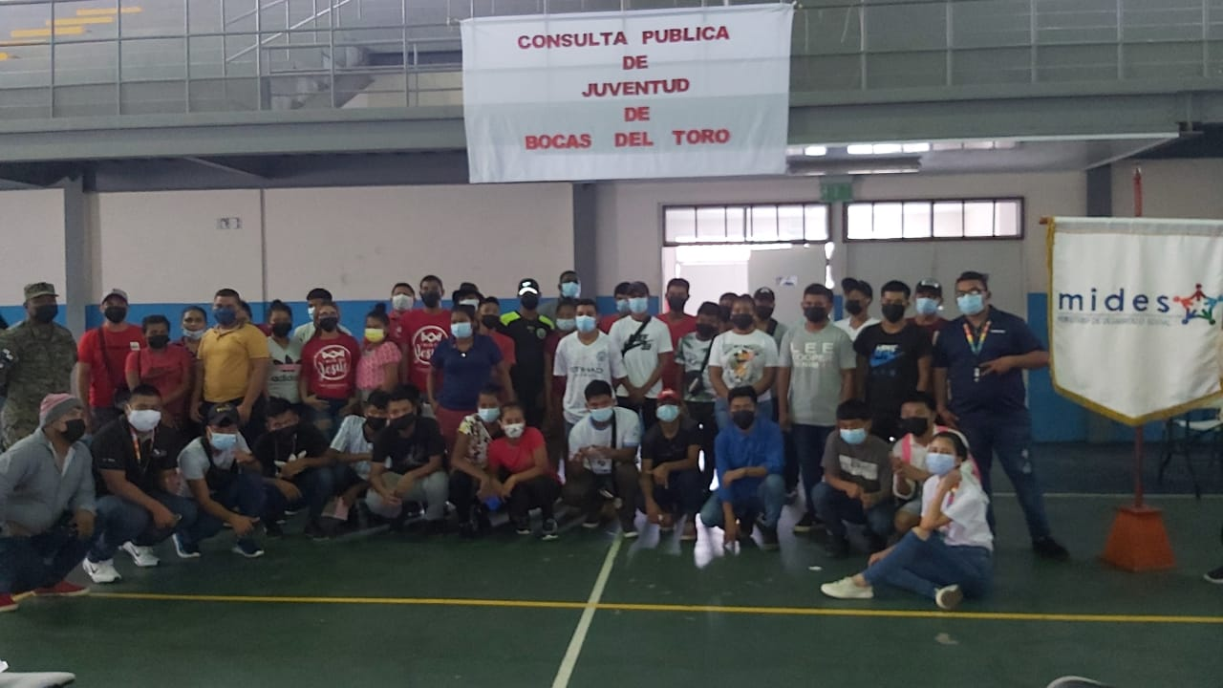
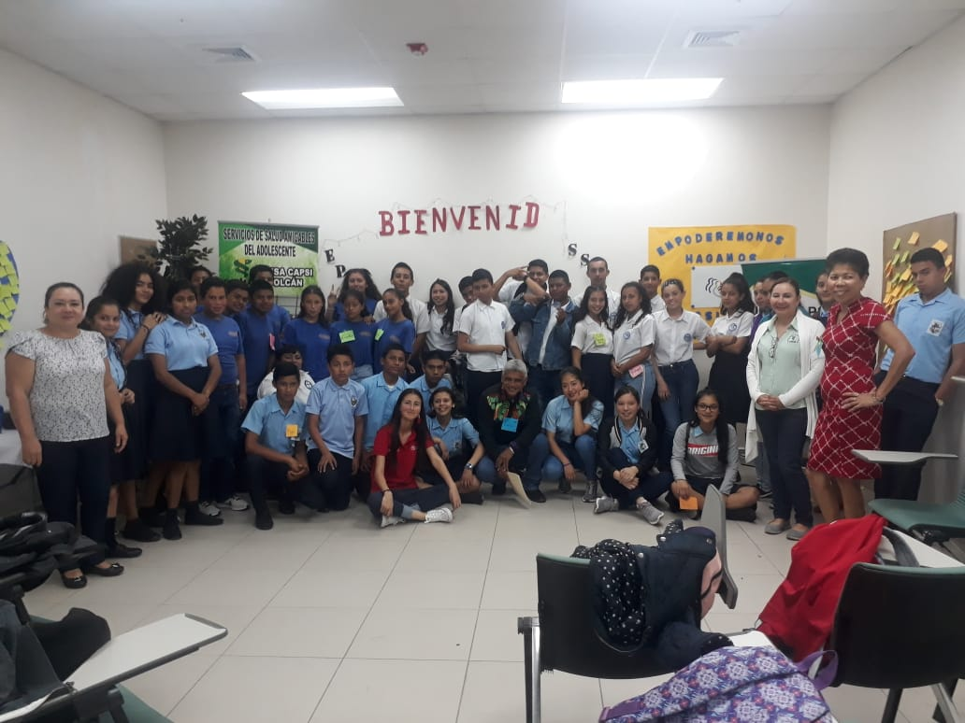

The time to act is NOW!!
Rural youth MATTERS!!
DO WE COMMIT TO THEM?
@masj_2000

